Slide 1
Things to do –
Output navigation model from opencv in an array
Trained navigation model in opencv as an array
Optional extra- output steering direction as video outputs into pygame. [racing game or snake]

Slide 2
How self driving cars work in one picture

Slide 3
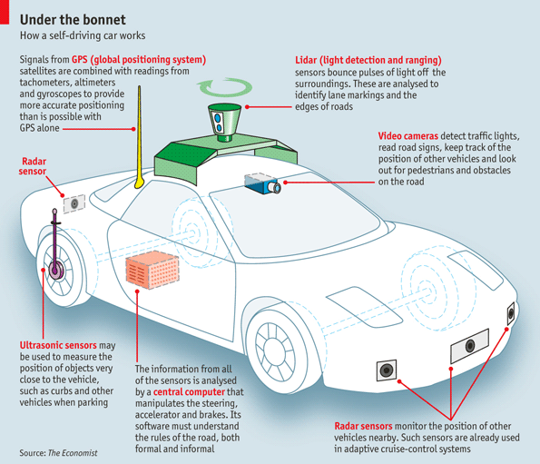
How self driving car works with slam
Cars such as Tesla, Google, Nvidia and open sources projects such as comma AI are all working to achieve self driving vehicles by simulating how the bran sees and moves.
[Include picture of brain, eyeballs seeing to moving]
[using vision as the eyes and neural net as the brain we’ll train the car to move ]

Slide 4
Features of today’s self driving cars. http://www.economist.com/blogs/economist-explains/2013/04/economist-explains-how-self-driving-car-works-driverless how sef driving cars work
reading signs
traffic lights
Identifying pedestrians
Ultrasonic detectors provide more accurate mapping of the surroundings at short range

Slide 5
Genetic algorithm vs machine learning
https://en.wikipedia.org/wiki/Evolutionary_algorithm
What is the difference between genetic algorithms for approximation and modelling vs artificial neural networks - https://www.quora.com/What-is-the-difference-between-genetic-algorithms-and-artificial-neural-networks
Artificial intelligence – Initial approach was to use genetic algorithms which is a type of “evolution algorithms”, to which are optimisation algoritm based on sensor data from ultrasonic sensors. This mimics some functios of what a self driving car can do.
Results worked well in approximating solution based on knowing the parameters of the given environment. This algorithm is used to model and mimic functions of a car such as in a convoy on a motorway following an object (car) that is directly in front of it.
Artificial neural network is a type of machine learning technique inspire by how the the biological brain processes signals using nerons. Neural netowors have successfully been implemented in areas for speech recognition and computer vision problems.
Problems facing genetic algorithms. Genetic algorithms don’t scale well with automating complex tasks which require more human intelligence in environments such as speech recognition or diagnosing diseases or self-driving vehicles. Neural Network approach is something that has existed for decades however Recent progress in computational technology means we are able to process better machine learning algorithms to simulate how a biologically inspired computing technology.
Today agoogle’s deep neural network algorithms are capable of learning to play games by itself.
With genetic algorithm the conditions have to be perfect and precise. The software is merely carrying out a set of instructions. However
Genetic algorithm is used to find exact approximations and and can be optimised to fit a model
Supervised machine learning takes input and output to find patterns.
Takes data and uses neural network to sort data.

Slide 6
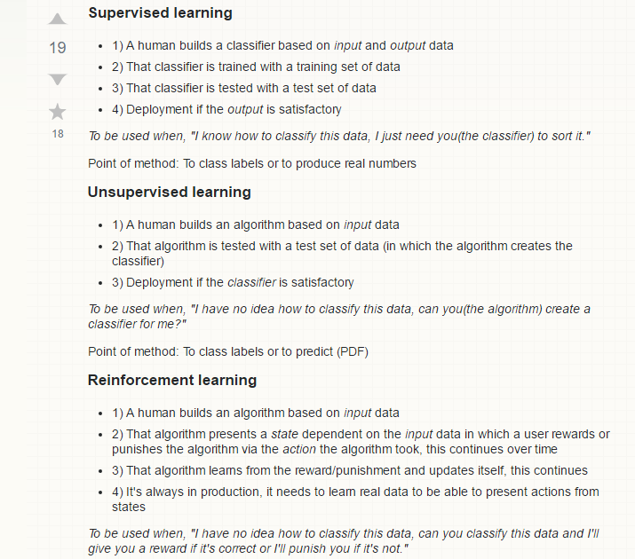
Different approaches to machine learning
https://stats.stackexchange.com/questions/144154/supervised-learning-unsupervised-learning-and-reinforcement-learning-workflow
http://www.techworld.com/big-data/why-does-google-need-deep-neural-network-deep-learning-3623340/
https://www.forbes.com/sites/bernardmarr/2016/12/08/what-is-the-difference-between-deep-learning-machine-learning-and-ai/3/#9b2de6d58344

Slide 7
Machine learning selection
Supervised machine learning algorithm
Feed forward artificial neural network
1 hidden layer
https://en.wikipedia.org/wiki/Artificial_neural_network
https://en.wikipedia.org/wiki/Feedforward_neural_network

Slide 8
How supervised machine learning works -
Udacity course onneral nets https://www.youtube.com/playlist?list=PLCYjDrbXmogriIF6R9Lu0u0UvgqXq3NBn
Udemy course on neural nets
Make your own neural net – tariq.

Slide 9
Back propagation – form of gradient descent
back

Slide 10
CURRENT SELF DRIVING CARS

Slide 11
Nvidia video on how its BB8 AI car drives
Creating a virtual world based on what it sees around it.
Detecting objects via visual camera to update camera.
Can we detect lanes?
Can we detect road signs ?
I didn’t want to be detecting cones, cars, absence of
I want the car to imitate what people actually drive. I don’t wont to describe this using equations or preprogrammed routines. I want to generalise driving behaviour purely based on molecular vision.
Can I drive with lanes and without lanes. crossroads? Sharp turns ?
With no map I want to imitate how I was able to drive the vehicle.
Learn the art of driving even in the dark?
SO WHAT IS THE CAR SEEING?
So I looked at zheng weng project which is an open platform. I took ideas from the project and created the Kwaku-alpha 1 AI car.

Slide 12
GOOGLE self-driving car

Slide 13
How George hottz built a self driving car in his garage. https://www.youtube.com/watch?v=w8PR5wKT9VA
His car learns to drive like a human

Slide 14
Build a Self Driving Car in 5 Min - Fresh Machine Learning #6 - https://www.youtube.com/watch?v=hBedCdzCoWM&t=123s

Slide 15
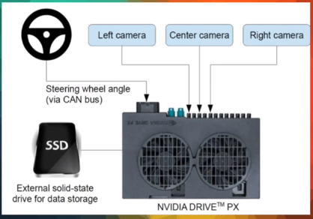
Build a Self Driving Car in 5 Min - Fresh Machine Learning #6 - https://www.youtube.com/watch?v=hBedCdzCoWM&t=123s
Similar layout of this is used for my rc car.
Raspberry pi isused insta of Nvidia drive.
Pi camera is used instead of the 3 front facing cameras
Shallow neural network isused instead of deep convolution neural network
Standard sd card is used instead of SSD.
Ultrasonic sensors are used as only input sensor for detecting objects around cars environment
Camera take input data ----→feeds this to neural network-→ driving features are learned through supervised learning of human driver --→(this removes need to use SLAM to map dynamic and infinite driving scenarios. This removes the need to decompose the driving scenario into localisation, perception, planning and control -→

Slide 16
METHODOLOGY – HOW MY RC CAR SELF DRIVES
Rccar learns to steer and accerate by watching the human driver and replicating this through neural netowkrs.
Once a button is pressed rccar dititises a jpeg image of the road ahead and records the steering and direction. This training image is reduced in resolution qvca(320x240) pixels and provides input to rccars 3 layer network.
The back propagation learning algorithm is applied via gradient descent to output the steering direction for the human driver.
The first layer of the networks navigation resonse is random de to the initialised weights however the model trains this over time to achieve the desired weights and output.
After training the model the network learns how to imitate the navigation of the steering driver
.This is saved that in an array. The button presses are mapped to the picture of what the car sees

Slide 17
Neural network layout

Slide 18
Hardware of the system
How system works
Different parts that come together
Background research

Slide 19
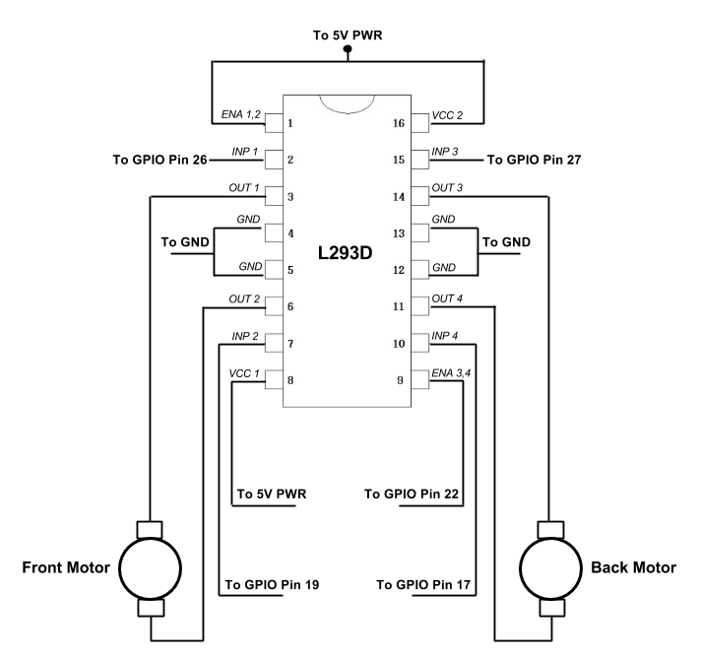
Motor driver wiring to car
Notes:
http://www.multunus.com/blog/2016/07/autonomous-rc-car-using-raspberry-pi-and-neural-networks/
We'll connect two GPIO pins( GPIO17 and GPIO27) from the Raspberry Pi to the two Input pins for Motor 1(Input 1, Input 2) of the IC and another GPIOpin(GPIO22) to the Enable pin for Motor 1(Enable 1,2) of the IC. We'll connect the Output pins for Motor 1(Output 1, Output 2) of the IC to the back motor. With this approach, we can control not only the forward/reverse direction of the motor but also the speed of the motor by setting the frequency and duty cycle of the PWM output to the Enable pin. Similarly, two GPIO pins(GPIO19 and GPIO26) from the Raspberry Pi are connected to the two Input pins for Motor 2(Input 3, Input 4) of the IC and the Output pins for Motor 2(Output 3, Output 4) of the IC is connected to the front motor. We have now eliminated the need for any radio transmitter to control the movement of the car.

Slide 20
SOFTWARE
Pygame – read keyboard strokes
Opencv library – use vision to train neural net
Arduino – motor controls of car
Serial – used to communicated keybard from Arduino to pc through python
Sockets – used to stream images from pi to pc

Slide 21
Pygame
Measures keyboard strokes (frames per sec) though serial connection. Frames per sec is set by “clock.tick(60)”
Image location. Top left is (0,0) as you add to x you move to right and as yo add to y you move down.
Why use pygame?
“well, as the method is Supervised Machine learning it needs Train Data as well as label So as Py Game is a cross-platform set of Python modules designed for Games with Keyboard Support libraries, we can use our keyBoard Arrows to Drive our Car ( For training purpose ) . as this point we save those Arrays ( arrow driving methods) as a label. for better understanding”

Slide 22
Streaming camera pi to laptop via sockets
https://gist.github.com/bigsnarfdude/5c1456af12577584ecb900abaa48497c

Slide 23
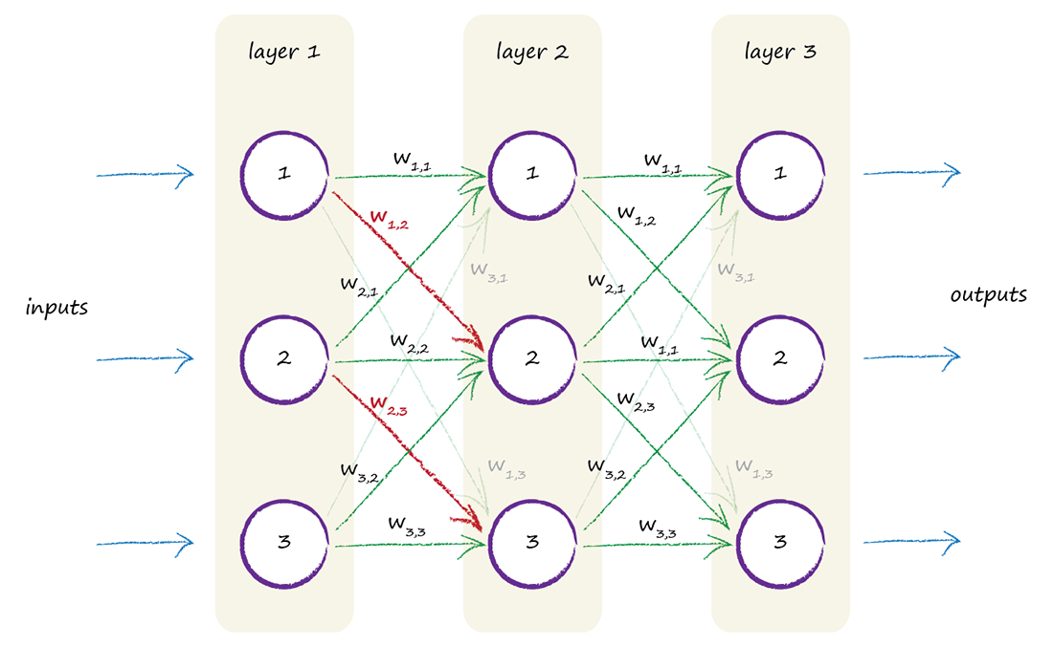

Slide 25
REASEACH TOPCIS
COMPUTER VISION - opencv
PYTHON – PYGAME, NUMPY, SERIAL, SOCKETS
NEURAL NET HOW TO
How to train neural net book
Siraj videos youtube
Ryan zotti neural net youtube
Zheng whang project
ACADEMIC PAPERS

Slide 26
Udemy computer vision
Using computer vision to see and understand the world around us.
Difficulty in life – background clutter, object class variations, ambigious images/optical illusions.
Images stored in numpy arrays which allows us to carry out powerful mathematical operations for streaming images and neural network calcs.
Definition of what are images? “Images are 2 dimension representation of the visible light spectrum”
So the question is how do we train the pc to focus on images seeing and varying light conditions and varying light details. We identify objects faces and classify them easily the challenge is how to get a camera on board a raspberry pi to process these images they are seeing and classify then into acceptable computational data for navigation? The answer one of the more popular methods is the approach and use supervised learning methods such as neural networks. The brain uses 6 layers of visual processing we are trying to replicate this with neural netowrks.

Slide 27
How opencv stores images?
RGB this is converted into grayscale as an 8bit integer ranging from 0 to 255. open cv captures the 3 dimensional images streaming in and conversts them into 2 dimensional arrays which can then be processe mathematically using matrices to compute our nural networks. Values in greyscale image are used in calculatiosn where darker images represent smaller values 255-white black-0.
What is opencv?
Open source computer vision to consolidate computer vision research written in c++. I’m using the pithing version of the software for simplicyt and use of numpy.

Slide 28
Client server connection
Cleint- pc. Server – pi. The pi streams images from its server to the host pc (client) pc over wifi by implementing the use of sockets in python.
Client programs run on the raspberry pi to stream images in jpeg format into opencv via sockets. The resolution of the video stream is reduced to achieve low latency. []why?]
Multithread tcp server runs on pc to receive the streamed images which are streamed into open cv and converted into numpy arrays.

Slide 29
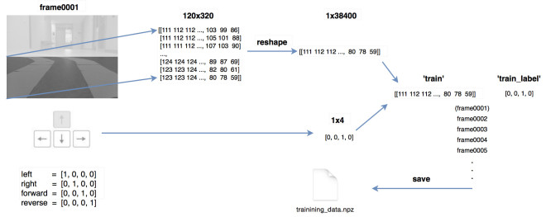
Training neural network using MLP in opencv http://docs.opencv.org/2.4/modules/ml/doc/neural_networks.html# this is the guide on how to use ANN functions in opencv
Example code of implement an ANN in opencv http://www.swarthmore.edu/NatSci/mzucker1/e27/simple_nnet_example.py
How Zheng Whang neural net transfers images to keystrokes in pygame to control the RC car.
https://zhengludwig.wordpress.com/projects/self-driving-rc-car/
Camera view seen by the car.
Location of the human driver

Slide 30
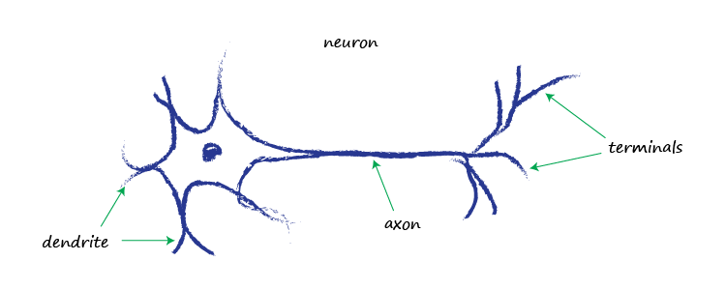
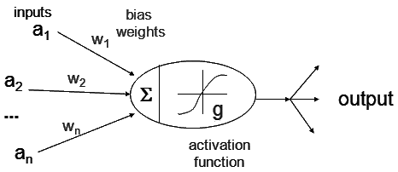
Maths behind how neural network works
Feedforward neural network is an adjustable function that models how the brain works. Comparing the predicted model with our ACTUAL model. [handwriting example]
Uses back propagation to train our model.
By adjusting the weights (W), you can make the function behave differently. Backpropagation is a method of adjusting that error to find the correct value for our weights through numerous iterations.

Slide 31
Scenarios for the VIVA
Scenario – nural net: simulate lane keeping on a racetrack and park in area at the end of thecourse.
Preprogramed routines: auto-park

